Slide 1
Beerazon
Steven Freed
John sweeney
Denny sabu
Cs 336
BeerbardrinkerPlus

Slide 2
Project outline
Database
ER Diagram
Schema
Data Generation
Backend
API endpoint
Serving requests from EC2
Frontend
Deployment on EC2
Styling

Slide 3
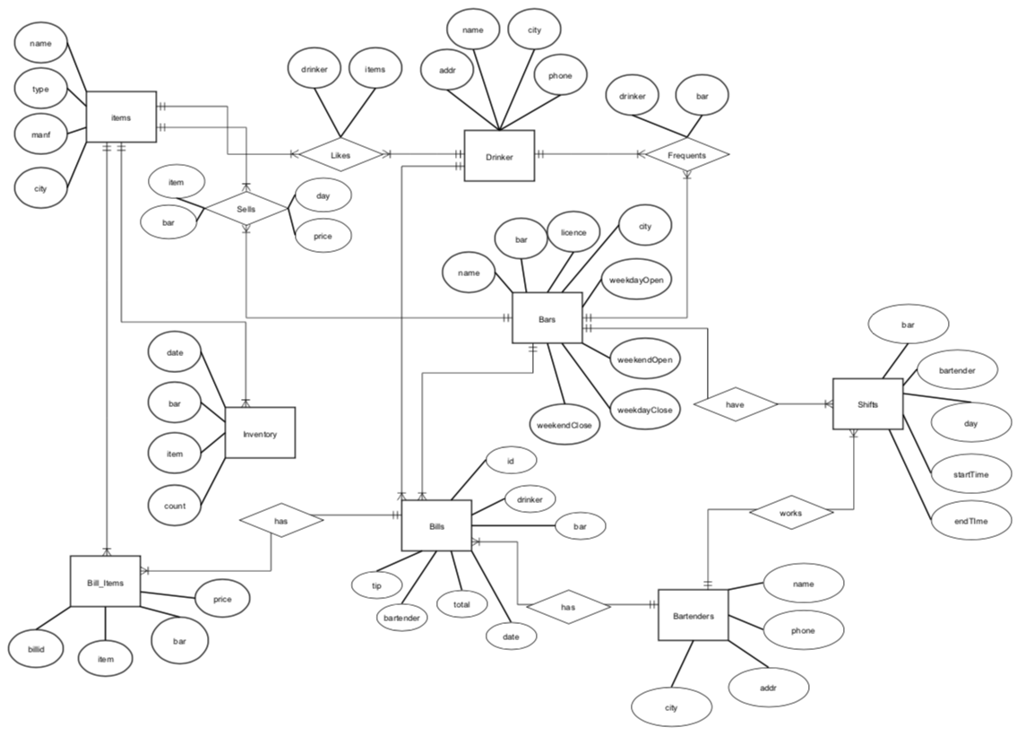
Database – ER diagram

Slide 4
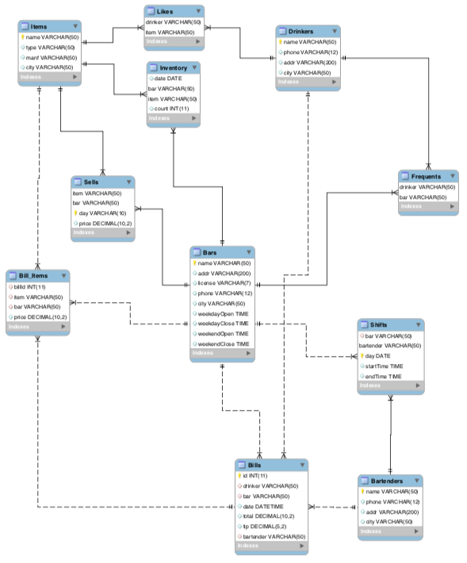
Database – Relational Schema

Slide 5
Database – data generation
We were first tasked with creating data to populate our data base with the needed information such as
Drinkers
Bars
Beers
To generate our data we used many resources that were at our disposal including
Online name, address, phone number generators
Actual real world data of top 100 bars in the world
Factious data such as dates, prices, and transactions time

Slide 6
Database – data generation
The creation of the fictitious data was achieved through programs using a variety of languages that were suited based on specific needs, languages like
JAVA
C++
Python
Many tables were dependent on the production of there tables and our programs needed to take these prerequisite tables as input to properly generate the current table
Example: the program for generating bills took the bill_items table as input

Slide 7
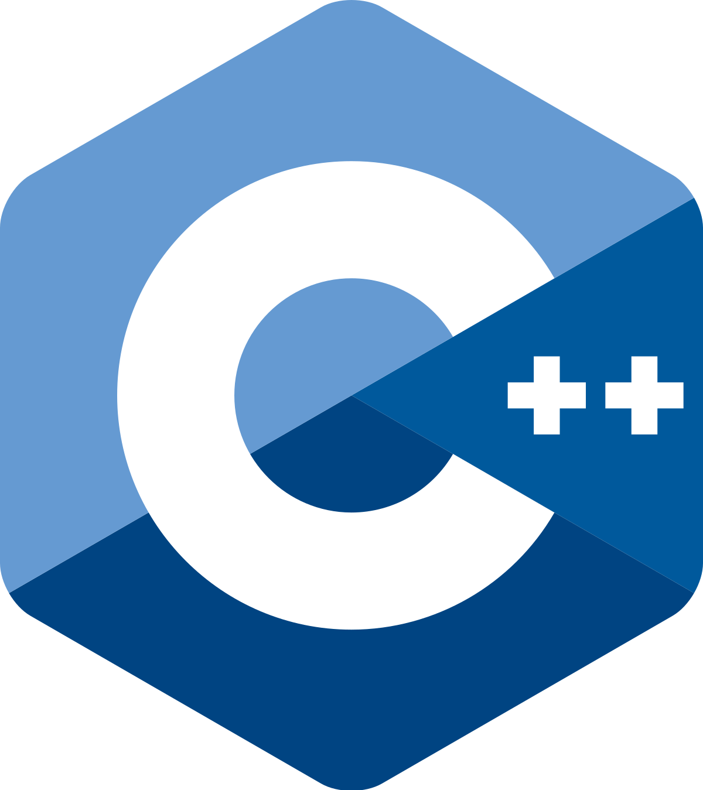
Database – data generation
These programs would output the correct table information in the form of CSV files that we would then import into our database
Furthermore our data generating programs were an integral part of this project as it is how we enforced our constraints on the initial data

Slide 8
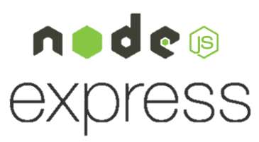
Backend – api endpoint
Created using Node.js and the Express framework
Light and flexible
Handling API requests
Keeping a secure connection to MySQL using a config file with our AWS RDS data
Using CORS (Cross Origin Resource Sharing) in order to communicate with our frontend
The React Fetch API required us to use CORS
API Endpoints for each MySQL transaction and query
YAML file
To keep documentation for our API allowing us to easily figure out what each endpoint does

Slide 9
frontend – sending requests
Fetch API
Mozilla api built into the React Framework
POST and GET requests
JSON data in the body for POSTS
JSON for GETS
Parsing JSON returned data
Using arrays, very easy in JavaScript

Slide 10

Frontend
Utilized the extremely popular React Framework to gain experience with the MERN Stack used in the web development industry.
React Framework allowed access to a wide array of open source libraries to assist with graphing of data.
Allowed for rapid development and testing before deploying.

Slide 11
Frontend – reactstrap
To improve the visuals of our overall project, we turned first to reactstrap.
Using the reactstrap components significantly improved the style of our website, making it look modern and sleek.
Without reactstrap, we would’ve had to style each item using only CSS which would take up many hours of development time.

Slide 12
Frontend – representing data
To effectively plot our data on graphs, we turned to the massive open source libraries available for React.
The Uber ‘react-vis’ library suited our needs nicely.
Ran into some problems regarding poor documentation.
Problems aside, configuring the graphs and populating them was fairly straight forward.

Slide 13
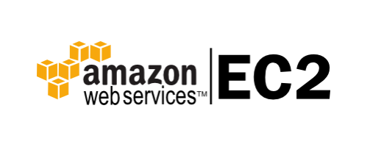
deployment
Tried to deploy frontend on Amazon S3 and backend on Amazon EC2, however, we ran into major problems allowing permissions for cross-server communications.
After much trial and error, we decided to host the frontend on EC2 at port 3000 and the backend at port 5000.
This allowed for a seamless transfer of information, and error free.

